Slide 1
Prolouge
First of all, Let me explain about the system of workshop. Slide describe about Registration, Speech Computer and Our life, Schedule and Lectures.

Slide 2
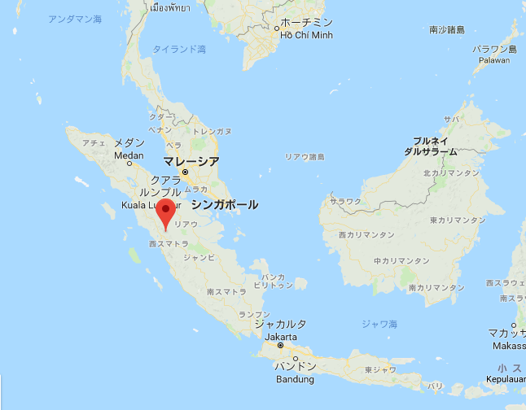
Introduction
Title:
Our life and IT
Sub Title:
The knowledge of IT is essential in this modern world. Let’s think and act how to use the computer in an easy way.
Let’s learn more knowledge in this workshop.
Target:
Think about IT in its past and future.
Learn to maintain the computer.
Get the skill of Word, Excel, Image, Video, Blog and Website.
Venue:
STT Payakumbuh Computer lab

Slide 3
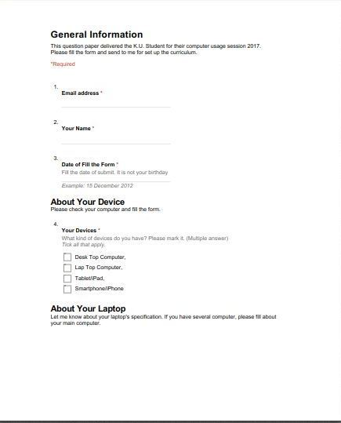
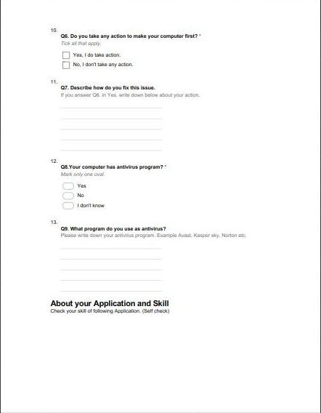
Registration Form Page01-03 (Sample)

Slide 4
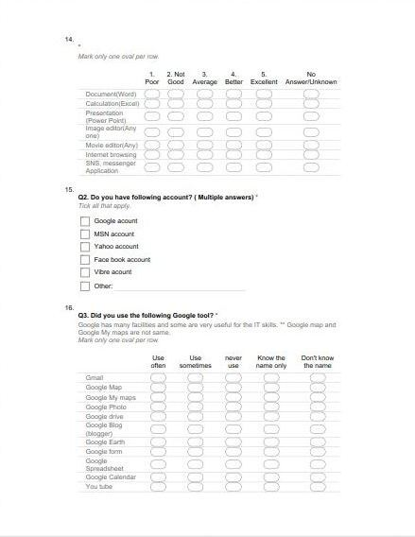
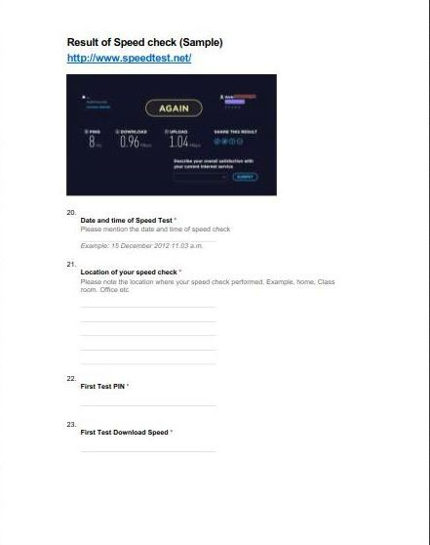
Registration Form Page04-06 (Sample)

Slide 5
Registration Form Page07 (Sample)
Link for Registration form
Registration start November 2018

Slide 6
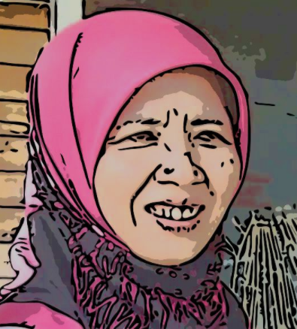
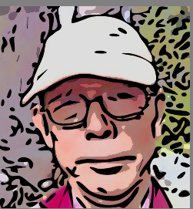
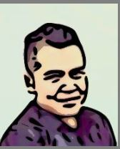
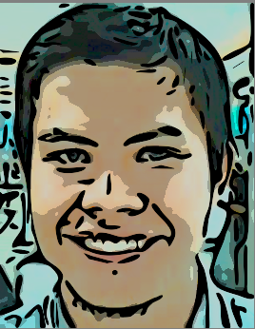
Lectures and Staffs
We help you !
Dr. Novarti : STTP
Satoru Hoshiba: Japan
Arif : STTP
Ramizl : STTP
Organize by STT Payakumbuh

Slide 7
Notice
Curriculum takes 40 hours (10 days in each 2hours).
Student can do self-study with the site both computer and smart phone any time and any place at http://hostinger.firebird.jp/
.
There is a group discussion on Word, blog, PowerPoint and Website.
After finish the lesson, students should submit the survey.
Please check Exact date of Lesson in Google Calendar.
Actual calendar will show during the session.

Slide 8
Image of IT Class
ONLINE MATERIAL
http://hostinger.firebird.jp/
1. General
Online Registration
2. Word
Group Discussion
3. Excel
Lesson
4. Image
Group Discussion
5.Blog
Conclusion
Group Discussion
6. PowerPoint
1. Online Survey
2. Closing Ceremony
Group Discussion
7. Website

Slide 9
Schedule (Google Calendar)
This is the Sample
Click the Sample Calendar to check exact calendar.
Exact date will clear on November 2018.

Slide 10
Page for Registration
Registration will start 30days before the Workshop.
Form can be available the following link below
It required password to go to the online registration 30days before the workshop starts.
Password for entry will delivered by email.
Click for the Registration
Temporally suspended.

